Slide 2
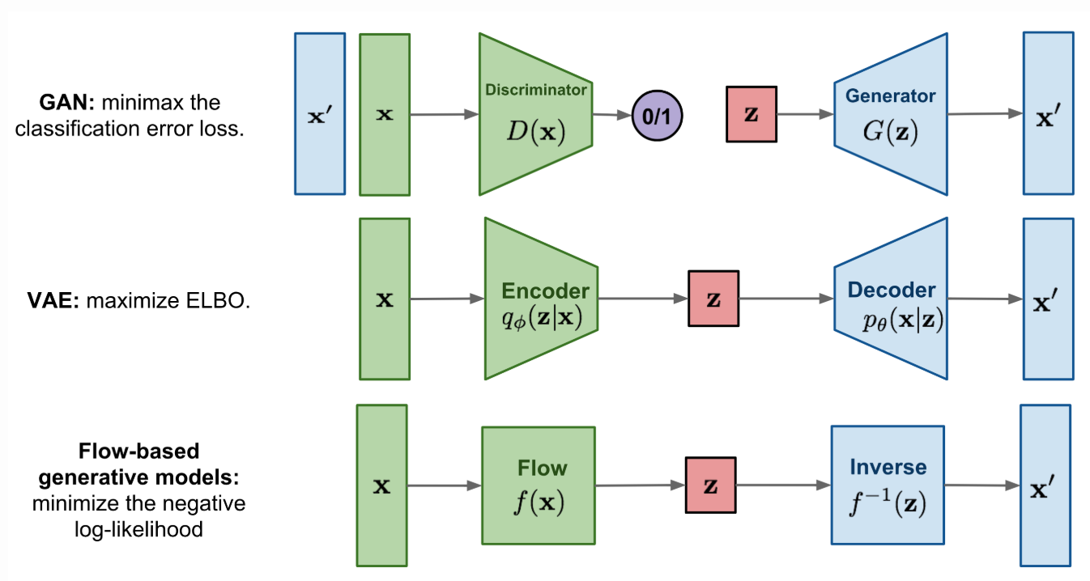


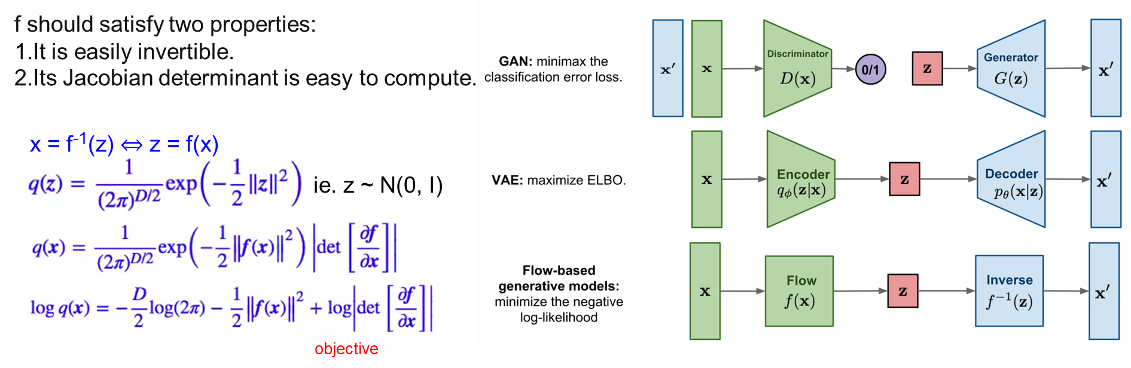

f should satisfy two properties:
It is easily invertible.
Its Jacobian determinant is easy to compute.
x = f⁻¹(z) ⇔ z = f(x)
ie. z ~ N(0, I)
objective

Slide 3
x = f⁻¹(z) ⇔ z = f(x)
ie. z ~ N(0, I)
objective
f should satisfy two properties:
It is easily invertible.
Its Jacobian determinant is easy to compute.

